Slide 1
Explore alignments (SAM/BAM) using pysam
Rahulsimahm Vegesna
GENOMIX WORKSHOP
2/11/2016

Slide 2
Structure of the Workshop
Background
SAM
SAM tools
pysam
Break and Pizza
Excercise

Slide 3
I. Background

Slide 4
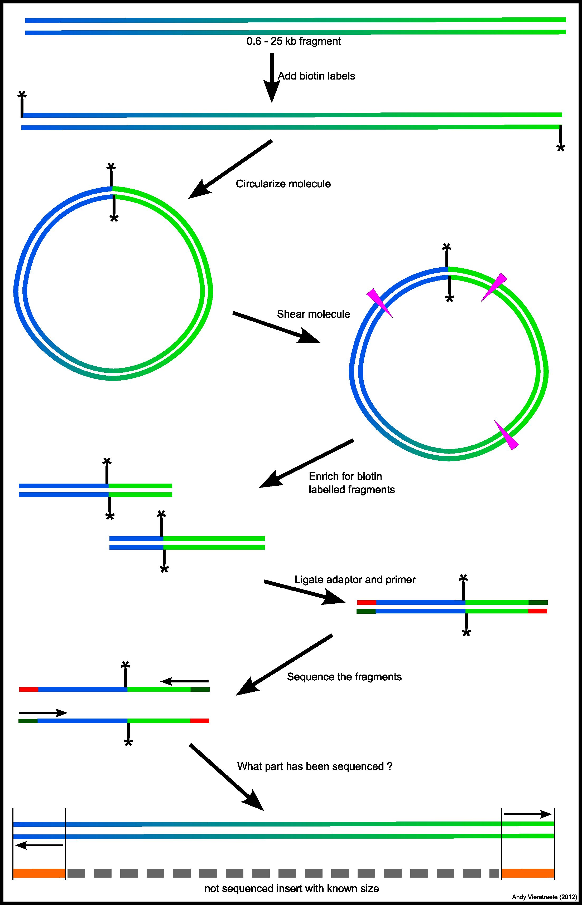
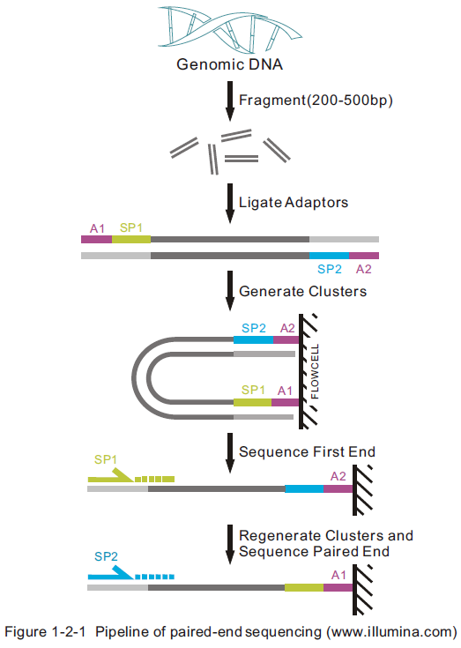
Sequencing types
Mate Pair
Paired End
http://users.ugent.be/~avierstr/nextgen/nextgen.html
http://www.genomics.hk/PlantWhole.htm

Slide 5
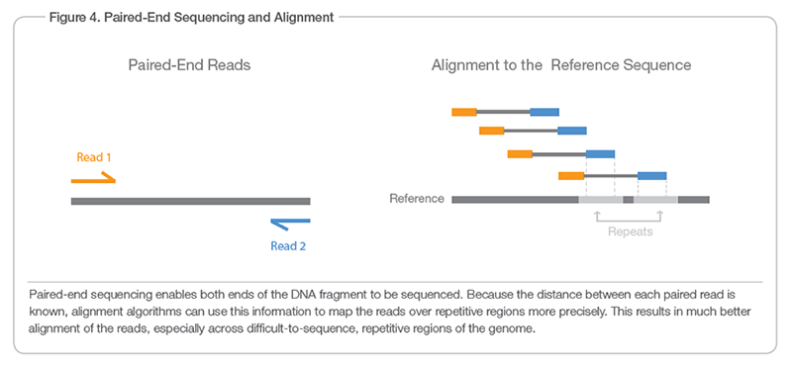
Read alignment
Millions of reads sequenced per experiment.
Sequence Alignment/Map (SAM) format to represent the alignment of each read.
SAM tools is handle huge SAM files.
http://www.illumina.com
Notes:
Information of the read : read id, seq and quality
Information of the reference: reference id, location
Alignment: quality, gaps, length
Information of the mate/pair read: location mapped to, index size.

Slide 6
II. SAM

Slide 7
SAM – Sequence Alignment/Map
Introduced by Heng Li in early 2009.
Cited close to 7500 times.
One of the most commonly used format for NGS alignment .
SAM file mainly consist of two sections:
Header (optional)
Alignment
http://samtools.github.io/hts-specs/SAMv1.pdf
Li, Heng, et al. "The sequence alignment/map format and SAMtools."Bioinformatics 25.16 (2009): 2078-2079.

Slide 8
SAM Header
Header is always prior to the alignment section.
Start with ‘@’ always
TAB-delimited except for @CO lines.
There are different record types storing specific information:
@HD Header represents the version info
@SQ Reference sequence info
@RG read group – description of the sample
@PG program – what programs were used to generate the current SAM/BAM file
@CO comment line
The data in each line follow ‘TAG:VALUE’ format where:
TAG – two letter thing that defines the format
VALUE – the content
List of required and optional tags are described in SAM format specification file.

Slide 9
Alignment
Each line represents linear alignment of a read/segment.
11 mandatory fields + optional fields.
TAB-delimited format.
Read id for both paired reads is the same.
First read or forward read id is followed by /1
Second read or reverse read id is followed by /2

Slide 10
Paired-end reads
Mate-pair reads
For each alignment we would like to know?
?
?
?
reference
A T C C T
?
A T T G C C T

Slide 11
Mandatory Fields

Slide 13
Header
1 2 3 4 5 6 7 8 9 10 11 Col

Slide 14
To remember
The sequence in the alignment file always represents the reference sequence and no the read sequence. (r003 seq in SAM)
The position are also with respect to the reference sequence.
Look at the FLAGS to know if the sequence is reverse complement or not.
Position are indicated by –ve sign in TLEN if the mate strand is in the complementary strand (r001/2 ).

Slide 15
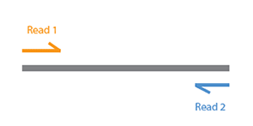
FLAGS – a bitwise set of information
are there multiple segments/reads? (two reads exist)
are all segments properly aligned? (read orientation)
is this segment/read unmapped? (say read1)
is the next segment/read unmapped? (read 2)
is this query the reverse strand?
is the next segment/read the reverse strand?
is this the 1st segment/read?
is this the last segment/read?
is this a secondary alignment?
did this read fail quality controls?
is this read a PCR or optical duplicate?

Slide 16
FLAG
Easy to understand using: https://broadinstitute.github.io/picard/explain-flags.html
Notes:
Supplementary line is chimeric alignment
Secondary alignment is multiple mapping .

Slide 17
CIGAR
Description of the alignments with respect to the reference.

Slide 18
BAM
SAM is a tab separated alignment file.
BAM is a compressed binary version of SAM.
Common way to store large number of alignments generated from NGS
It is compressed in BGZF format.
BAI is the index for a BAM file which is required for fast retrieval of alignments.
More info at : http://samtools.github.io/hts-specs/SAMv1.pdf

Slide 19
III. SAMtools

Slide 20
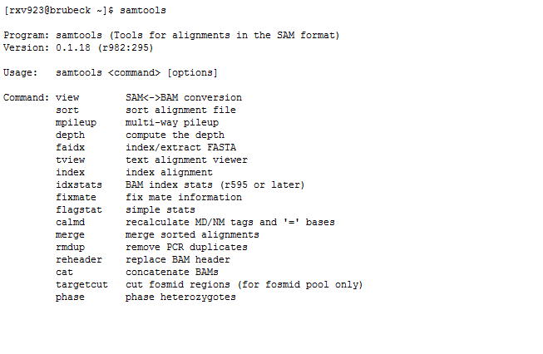
Samtools (http://www.htslib.org/)
Heng Li et .al (2009) The Sequence alignment/map (SAM) format and SAMtools. Bioinformatics, 25, 2078-9
http://davetang.org/wiki/tiki-index.php?page=SAMTools

Slide 21
IV. pysam

Slide 22
Check list:
Make sure you have:
Downloaded the BAM file.
Have pysam installed and loaded.

Slide 23
What will you learn?
File handle of SMA/BAM files
Parse alignment from regions of interest
Filter unwanted reads
Extract required reads
Create header and reads
Obtain coverage and haplotype for a particular location.

Slide 24
pysam – python wrapper for samtools
Andreas Heger et al. (https://github.com/pysam-developers/pysam/blob/master/AUTHORS)
Source: https://github.com/pysam-developers/pysam.git
Also warps bcftools and htslib
Documentation: http://pysam.readthedocs.org/en/latest/
Notes:
AH from Oxford

Slide 25
Working with pysam
Load the pyam package into your python environment:
import pysam
Let us know if you have trouble loading the package

Slide 26
File handle I/O: SAM pysam.AlignmentFile()
Read a SAM:
samfile_in = pysam.AlignmentFile("ex1.sam", "r")
Write to a SAM file:
samfile_out = pysam.AlignmentFile("ex1.sam", “w")
Close the SAM file:
samfile_in.close()
samfile_out.close()

Slide 27
File handle I/O: BAM pysam.AlignmentFile()
Read a BAM:
Bamfile_in = pysam.AlignmentFile("ex1.bam", "rb")
Write to a SAM file:
Bamfile_out = pysam.AlignmentFile("ex1.bam", “wb")
Close the SAM file:
Bamfile_in.close()
Bamfile_out.close()

Slide 28
Parse alignments from regions of interest : bamfile.fetch()
bamfile = pysam.AlignmentFile("ex1.bam", "rb")
for read in bamfile.fetch('chr22', 100, 120): print read

Slide 29
Filter unwanted reads and Extract required reads
bamfile = pysam.AlignmentFile("ex1.bam", "rb") pairedreads = pysam.AlignmentFile("allpaired.bam", "wbh", header=header) for read in bamfile.fetch(): if read.is_paired: if not read.is_duplicate: pairedreads.write(read)
pairedreads.close() samfile.close()

Slide 30
FLAGS: read.<FLAG>
is_paired true if read is paired in sequencing
is_proper_pair true if read is mapped in a proper pair
is_unmapped true if read itself is unmapped
mate_is_unmapped true if the mate is unmapped
is_reverse true if read is mapped to reverse strand
mate_is_reverse true is read is mapped to reverse strand
is_read1 true if this is read1
is_read2 true if this is read2
is_secondary true if not primary alignment
is_qcfail true if QC failure
is_duplicate true if optical or PCR duplicate
is_supplementary true if this is a supplementary alignment

Slide 31
Create new header : python dictionary
header = { 'HD': {'VN': '1.0'}, 'SQ': [{'LN': 1575, 'SN': 'chr1'}, {'LN': 1584, 'SN': 'chr2'}] }

Slide 32
Create a new read: pysam.AlignedSegment()
a = pysam.AlignedSegment()
a.query_name = "read_28833_29006_6945“
a.query_sequence="AGCTTAGCTAGCTACCTATATCTTGGTCTTGGCCG“
a.flag = 99
a.reference_id = 0
a.reference_start = 32
a.mapping_quality = 20
a.cigar = ((0,10), (2,1), (0,25))
a.next_reference_id = 0
a.next_reference_start=199
a.template_length=167
a.query_qualities = pysam.fromQualityString("<<<<<<<<<<<<<<<<<<<<<:<9/,&,22;;<<<")
a.tags = (("NM", 1), ("RG", "L1"))

Slide 33
a.cigar = ((0,10), (2,1), (0,25)) ; #(10M2I25M)
The cigar alignment. The alignment is returned as a list of tuples of (operation, length). If the alignment is not present, None is returned. The operations are:
Symbol | Description | Operation
M | BAM_CMATCH | 0
I | BAM_CINS | 1
D | BAM_CDEL | 2
N | BAM_CREF_SKIP | 3
S | BAM_CSOFT_CLIP | 4
H | BAM_CHARD_CLIP | 5
P | BAM_CPAD | 6
= | BAM_CEQUAL | 7
X | BAM_CDIFF | 8

Slide 34
Other applications:
Identify discordant reads .
Identify unaligned reads to look for junction, viral genomes or contamination.
Identify translocations.
many more…

Slide 35
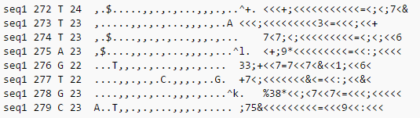
Pileup format:
Sequence identifier
Position in sequence (starting from 1)
Reference nucleotide at that position
Number of aligned reads covering that position (depth of coverage)
Bases at that position from aligned reads
quality of those bases (OPTIONAL)
. Base is on forward strand
, Base is on reverse strand
^ start of the read
$ end of the read
http://samtools.sourceforge.net/pileup.shtml

Slide 36
Obtain coverage : bamfile.pileup()
bamfile = pysam.AlignmentFile("ex1.bam", "rb")
for pileupcolumn in bamfile.pileup("chr1", 100, 120):
print ("\ncoverage at base %s = %s“ % (pileupcolumn.pos, pileupcolumn.n))
bamfile.close()
Notes:
indelindel length; 0 for no indel, positive for ins and negative for del
is_del1 iff the base on the padded read is a deletion

Slide 37
Obtain haplotype for a particular location.
bamfile = pysam.AlignmentFile("ex1.bam", "rb")
for pileupcolumn in bamfile.pileup("chr1", 100, 120):
print ("\nBases at position %s = “ % (pileupcolumn.pos))
samfile.close()
for pileupread in pileupcolumn.pileups:
if not pileupread.is_del and not pileupread.is_refskip:
# query position is None if is_del or is_refskip is set.
print ("%s“ % (pileupread.alignment.query_sequence[pileupread.query_position]))
bamfile.close()

Slide 38
Sort BAM file
pysam.sort("ex1.bam", "output") #samtools sort ex1.bam output
Command line options can be provided as arguments:
pysam.sort("-n", "ex1.bam", "output")
pysam.sort("-m", "1000000", "ex1.bam", "output")

Slide 39
V. BREAK

Slide 40
VI. Exercise

Slide 41
Exercise 1:

Slide 42
Working with AlignedSegment objects
Let's call our object “read”
read.reference_start: start position
read.next_reference_start: mate start position
read.is_reverse: TRUE if read aligns with reverse orientation to reference
read.mate_is_reverse: TRUE if mate aligns with reverse orientation to reference

Slide 43
Orientations of mate pairs
Convergent (forward-reverse)
Reference
Read 1
Read 2

Slide 44
Orientations of mate pairs
Divergent (reverse-forward)
Reference
Read 1
Read 2

Slide 45
Orientations of mate pairs
Parallel (forward-forward or reverse-reverse)
Reference
Read 1
Read 2
Reference
Read 1
Read 2

Slide 46
Exercise: orientation frequencies
What is the percentage of each of the three mate pair orientations (convergent, divergent, and parallel) in the bam file?

Slide 47
Exercise 2:

Slide 48
Additional commands
Get reference name (e.g. chromosome name)
read_id=read.reference_id
reference_name=samfile.getrname(read_id)
Get alignment start and end
read.reference_start
read.reference_end

Slide 49
Exercise: reads spanning region of interest
Read bam file and file with coordinates (reference name, start position, end position). For each coordinate, output how many reads span the region fully.
.............start.........end.........
..........--------------................. read1- doesn't count
...........----------------------.......read2 – counts
Verify in igv that your script matches the visualization

Slide 50
Exercise 3:

Slide 51
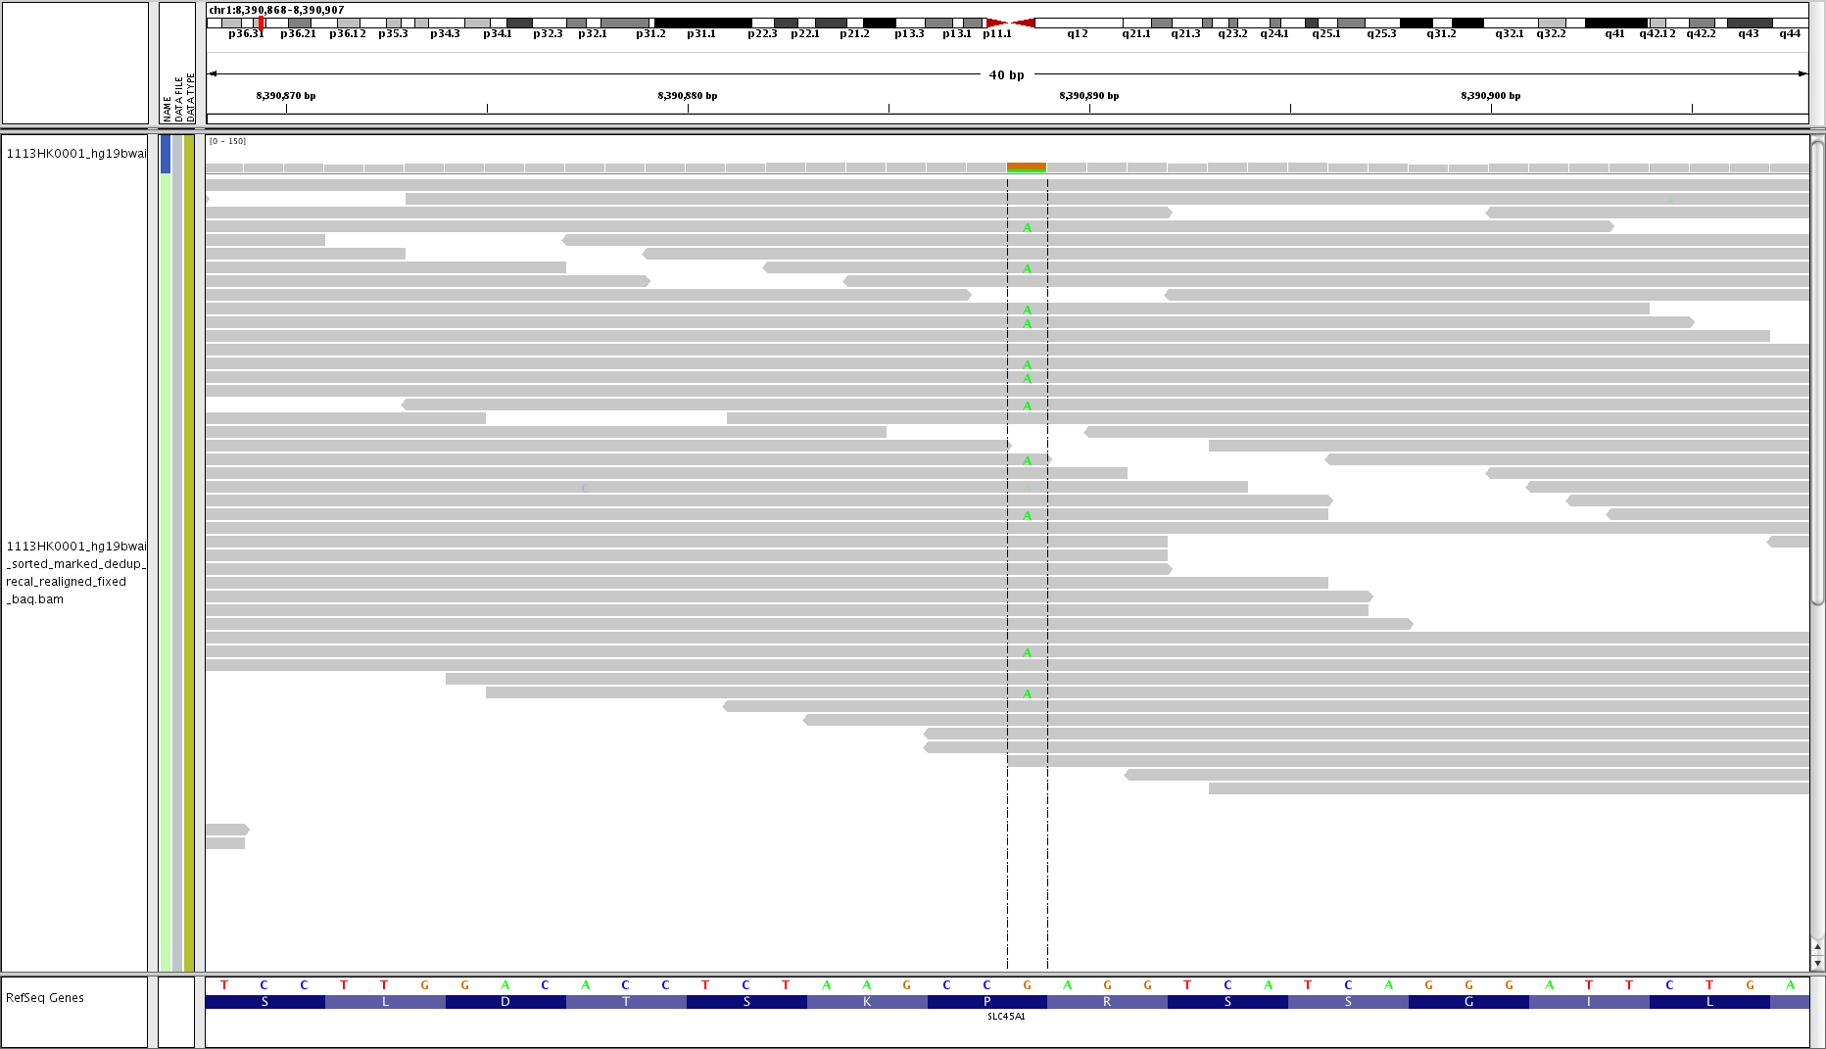
Exercise
You have a position of interest and would like to get information like:
Coverage at given position
What base is present at that position.
Is the location Homozygous / Heterozygous
Chr22:16958162

Slide 52
Installation
Pysam requires Python (2.6 or greater) and Cython (0.22 or greater).
pip install pysam
Or the manual install
git clone https://github.com/pysam-developers/pysam.git
python setup.py build
python setup.py install

